Slide 1
THE HAVELI
ARCHITECTURAL FEATURES AT ITS ANCESTORAL BEST
REVISITING AND RECREATING ALL THAT OUR ANCESTORS LIVED WITH BRINGS IN PRIDE & SATISFACTION TO BOTH THE DESIGNER AS WELL AS FOR US AT
GFRC FACADES

Slide 2
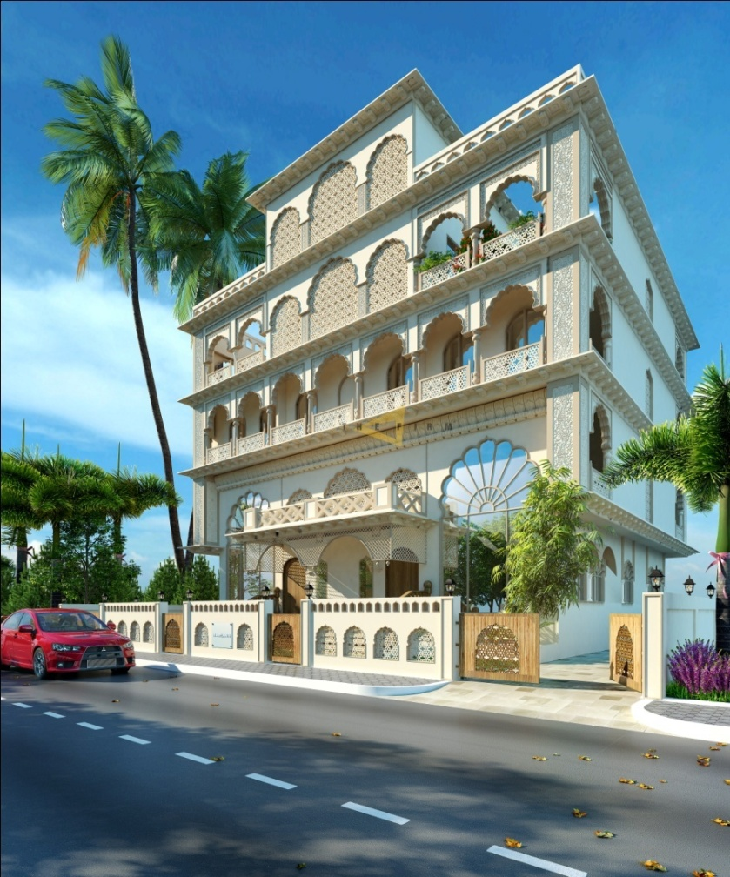
THE PERSPECTIVE

Slide 3
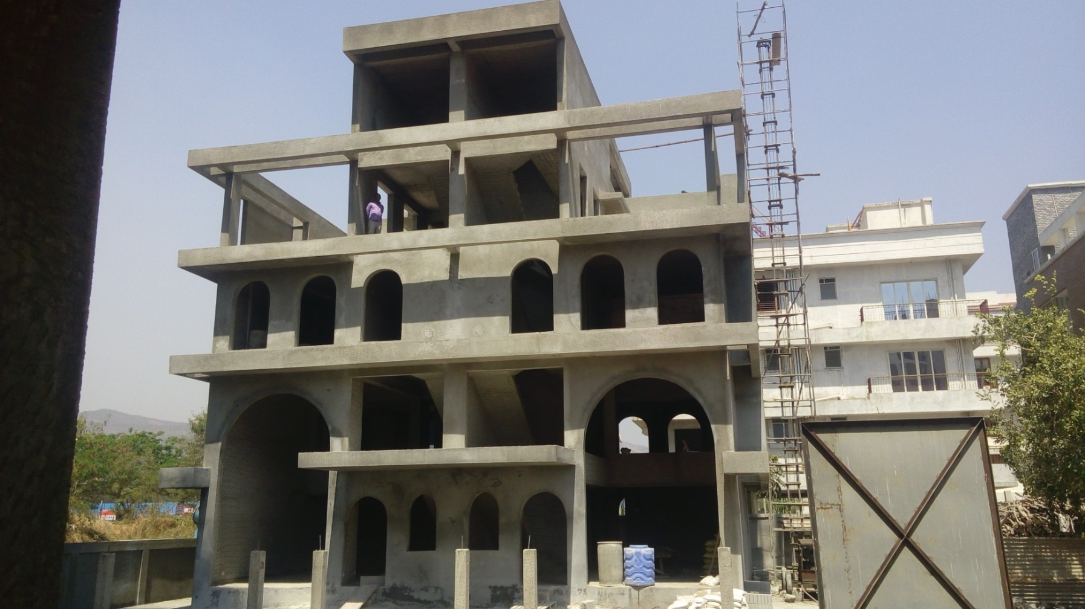
BASIC STRUCTURE AS PROVIDES TO US
THE FRONT ELEVATION

Slide 4
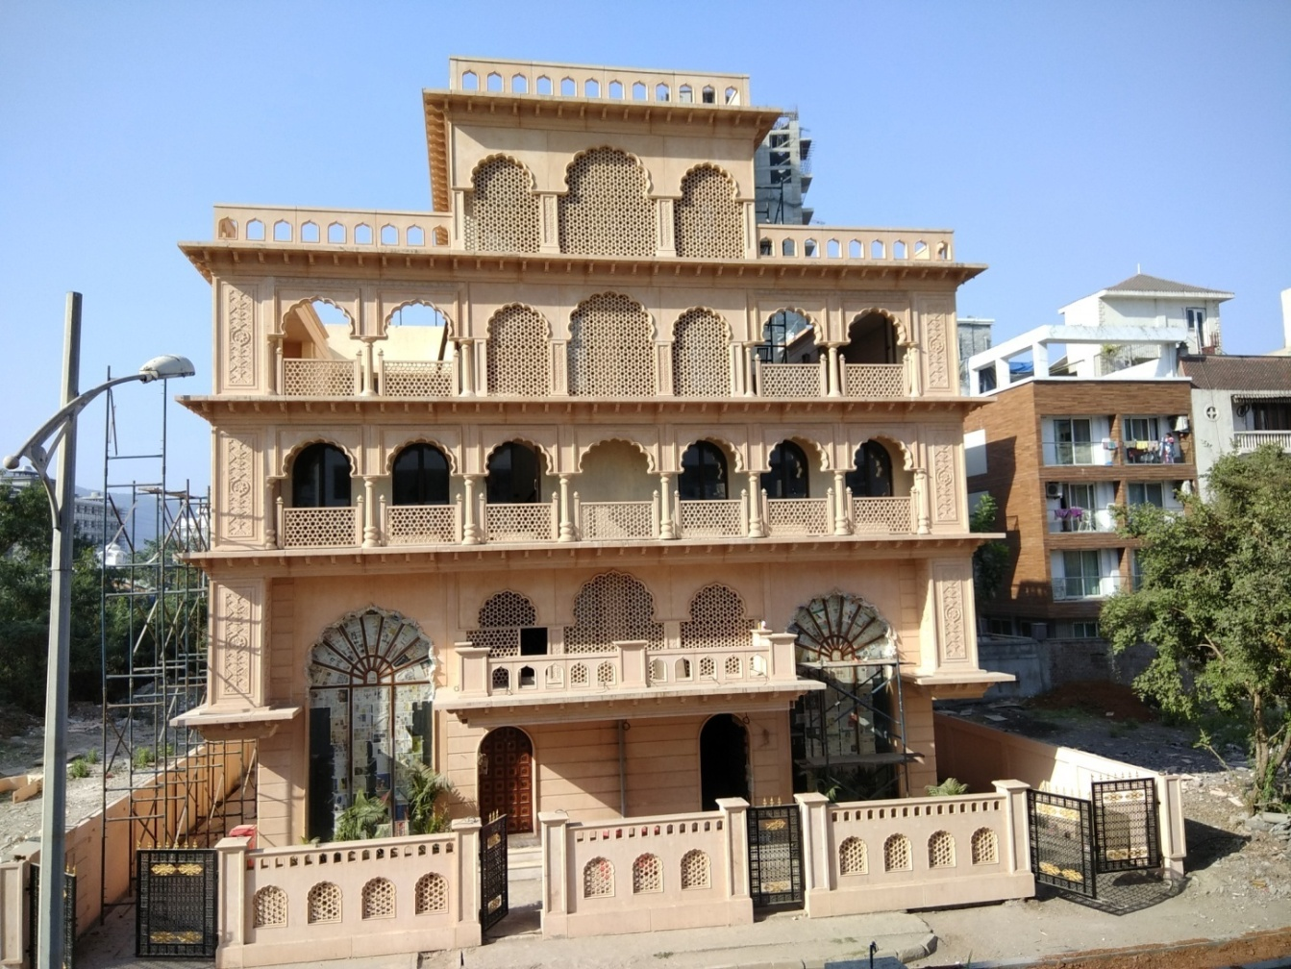
DESIGNERS VISION
TURNING INTO REALITY

Slide 5
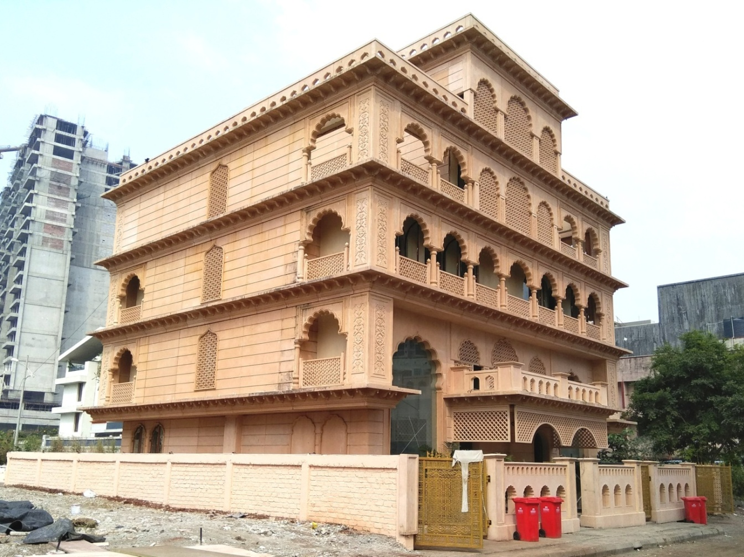
THE SIDE ELEVATION

Slide 6
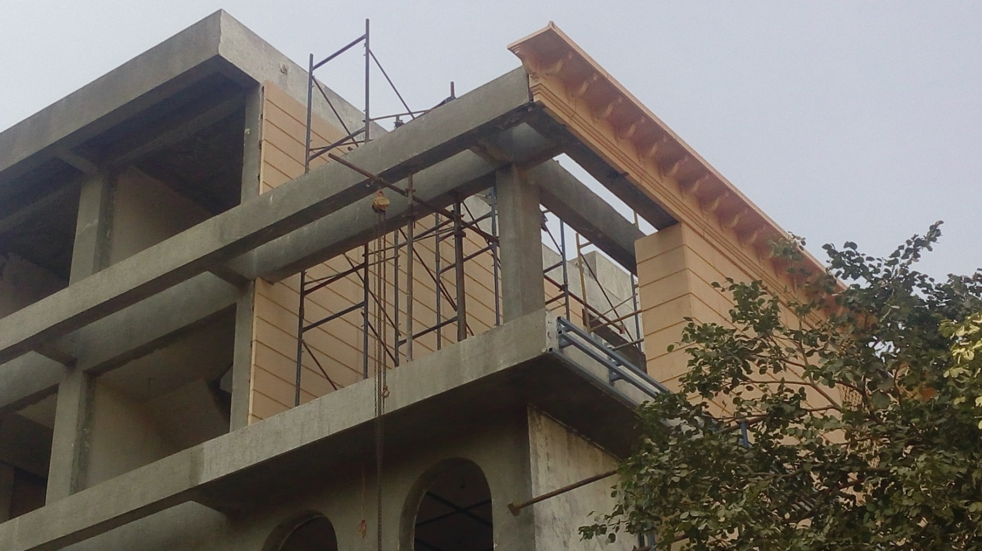
FRAMEWORK FOR FIXING THE CORNICE
THE FRAME WORK REQUIRED FOR FIXING ANY ELEMENT VARIES AS PER THE DESIGN OF THAT ELEMENT

Slide 7
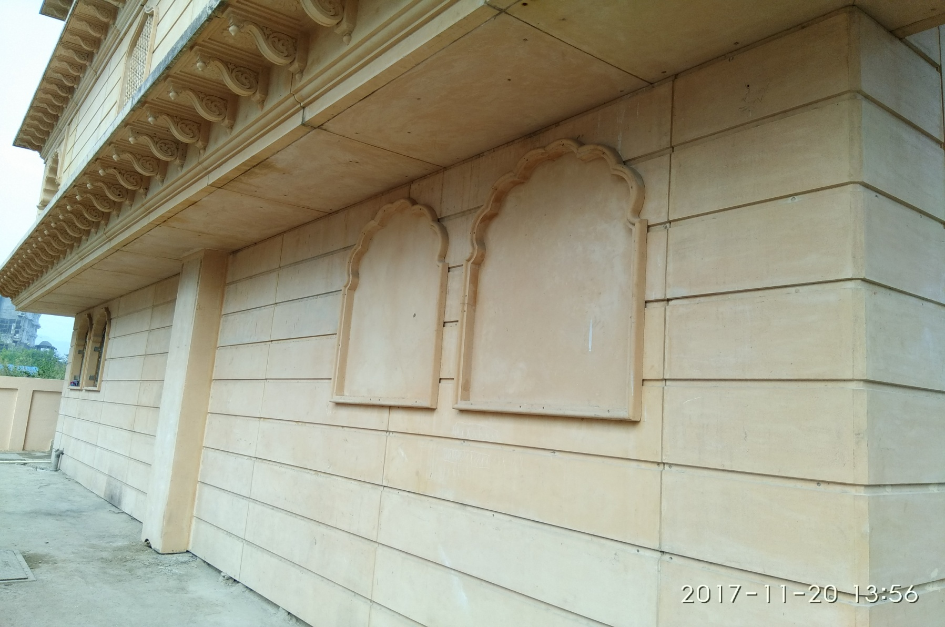
GRC PANELS

Slide 8
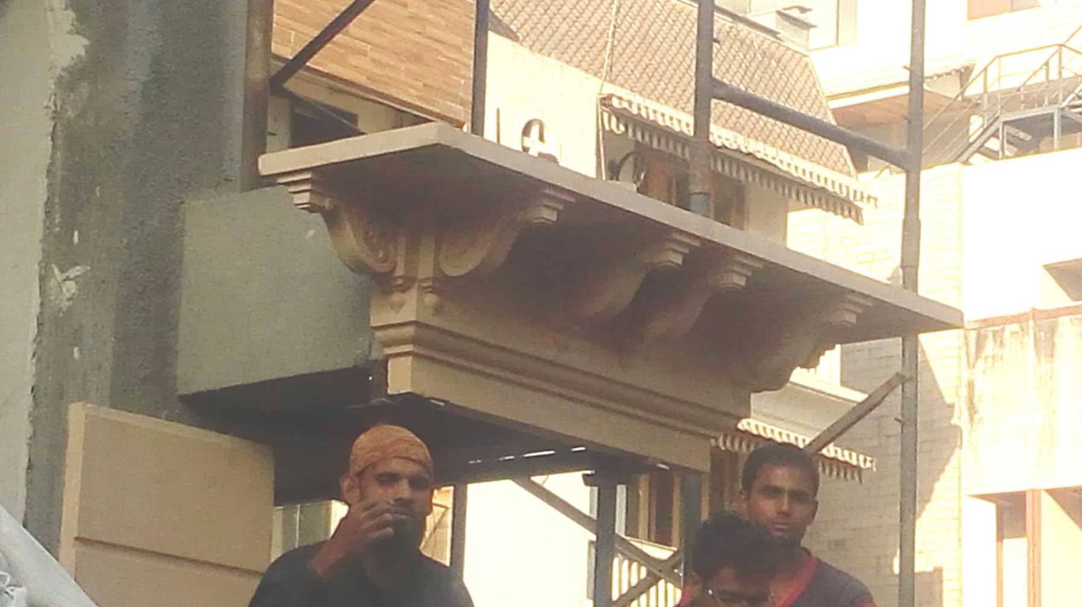
SPECIAL MOULD FOR CORNERS MADE FOR BETTER AESTHETICS

Slide 9
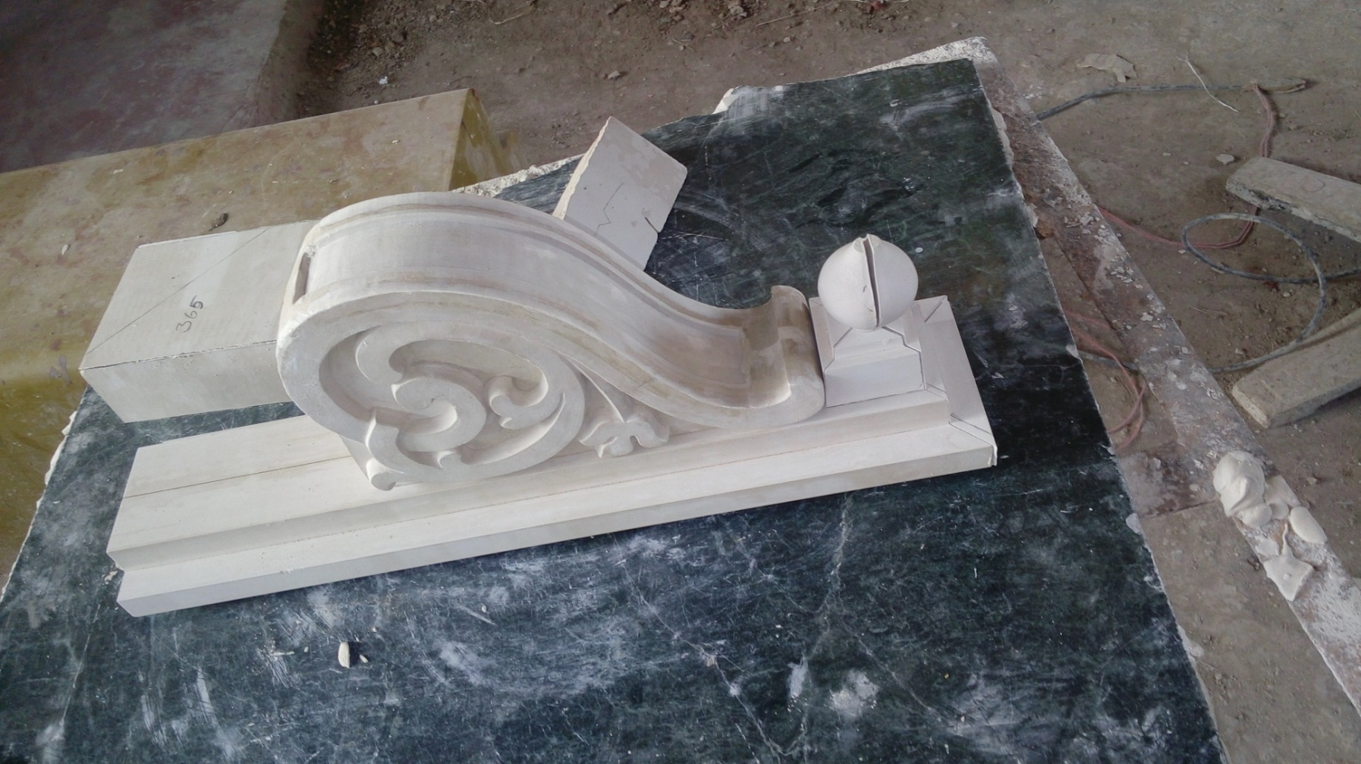
THE BRACKET - PATTERN

Slide 10
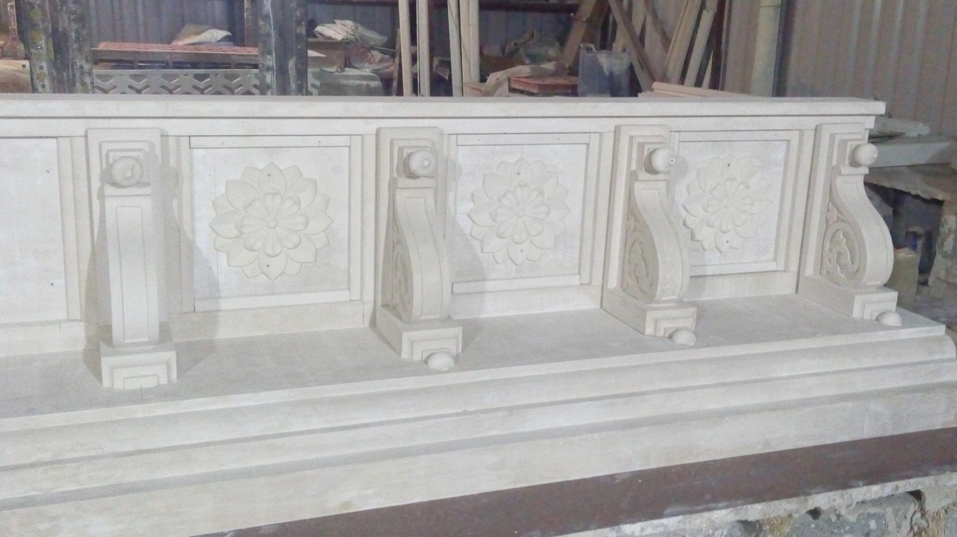
THE CORNICE PATTERN

Slide 11
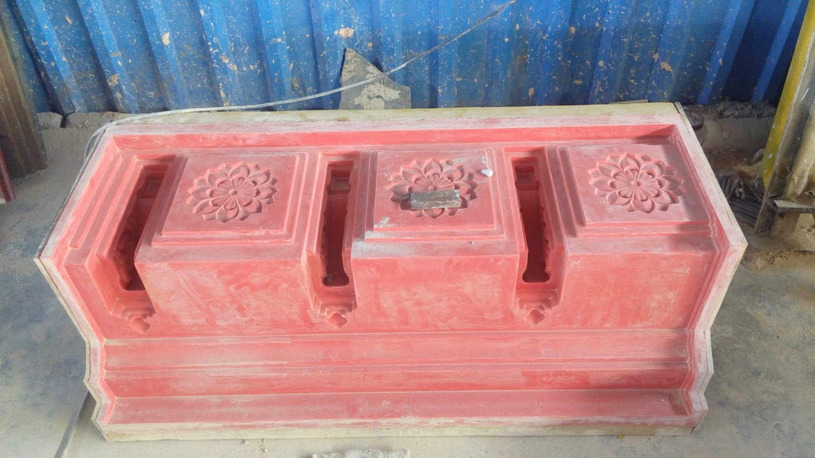
THE MOULD IN RUBBER

Slide 12
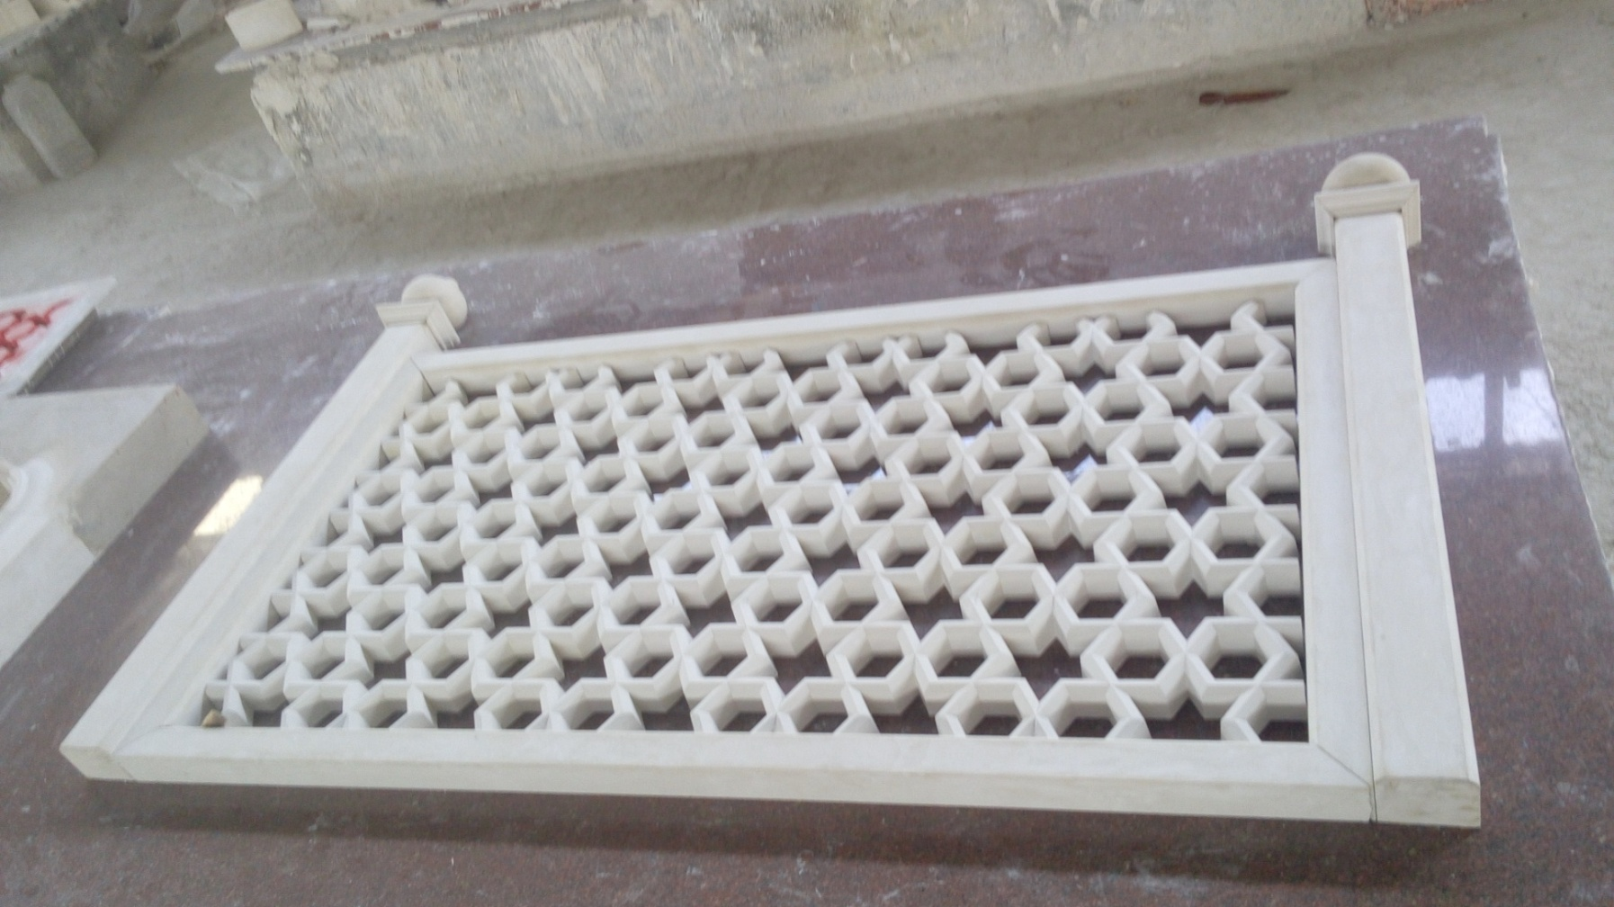
THE GRILL PATTERN

Slide 13
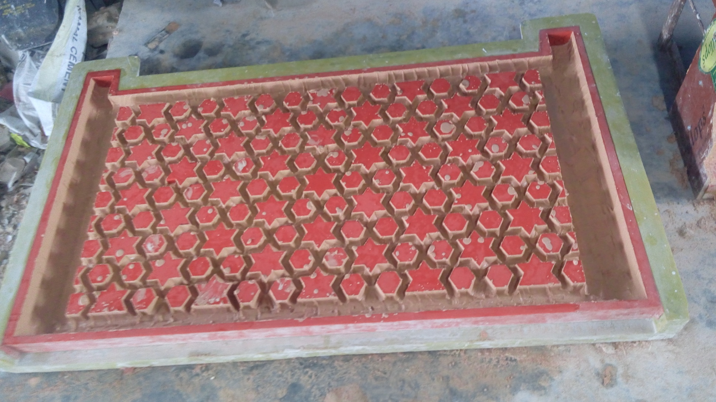
THE GRILL - RUBBER MOULD

Slide 14
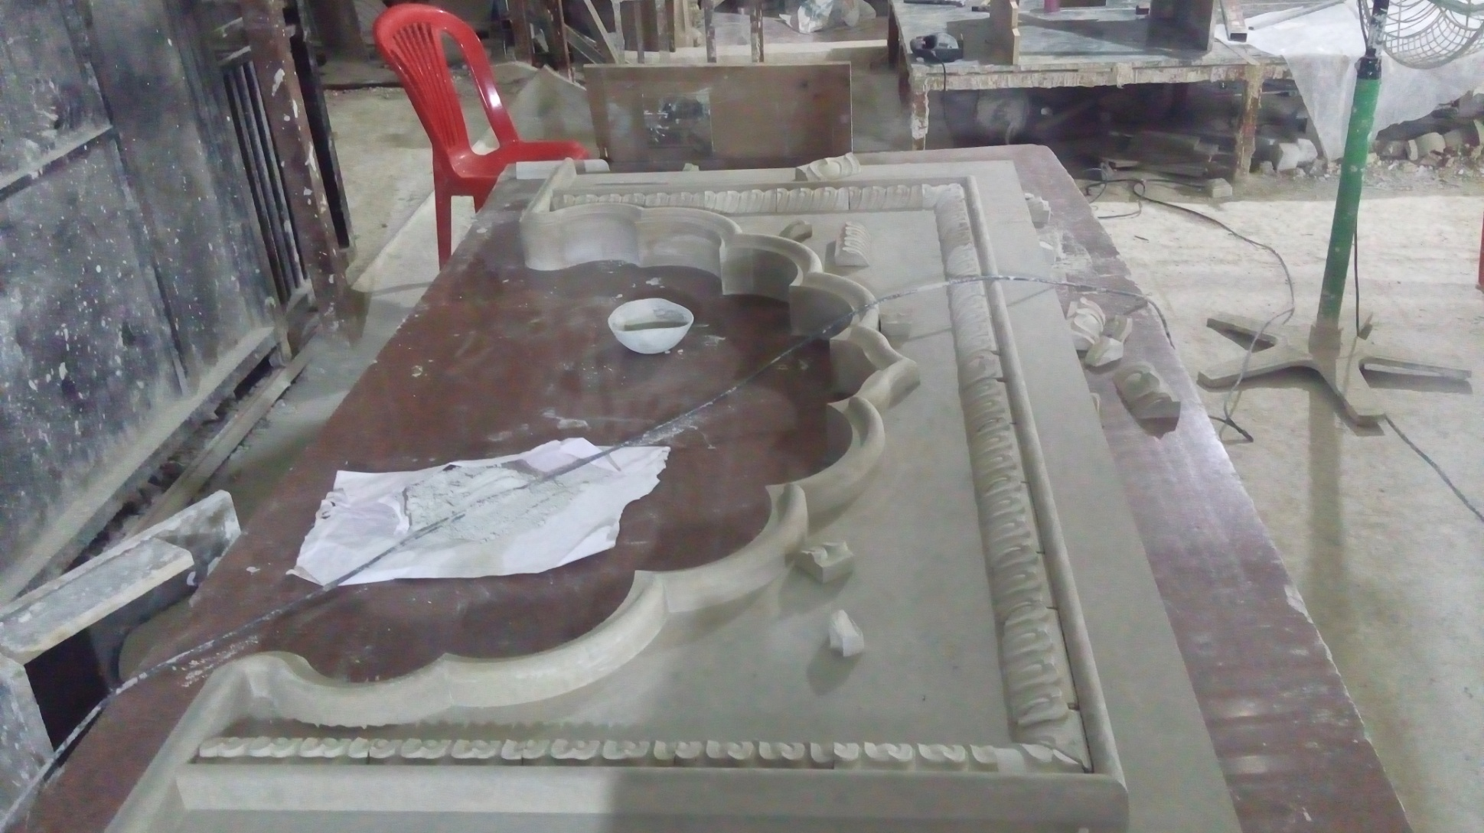
THE ARCH PATTERN IN POP

Slide 15
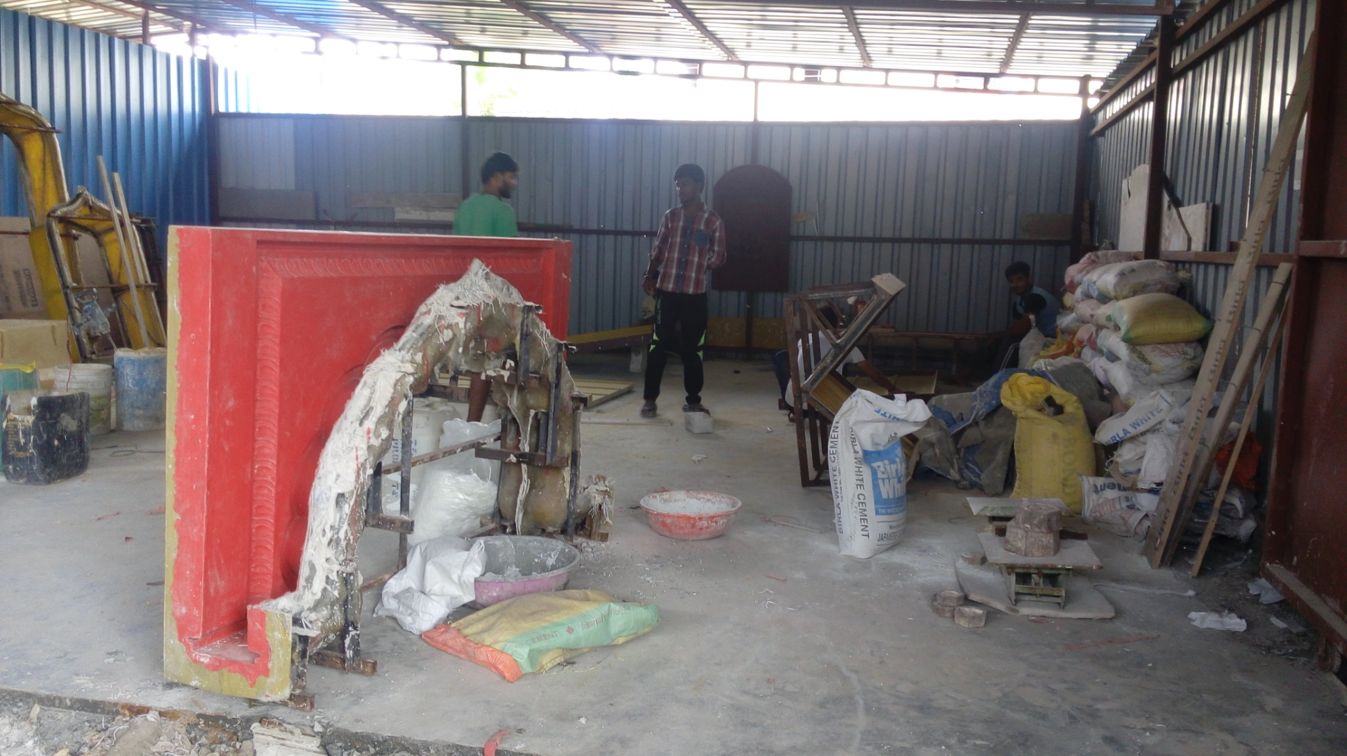
THE ARCH MOLD MADE IN RUBBER
FOR GETTING THE DETAIL DESIGN FEATURES

Slide 16
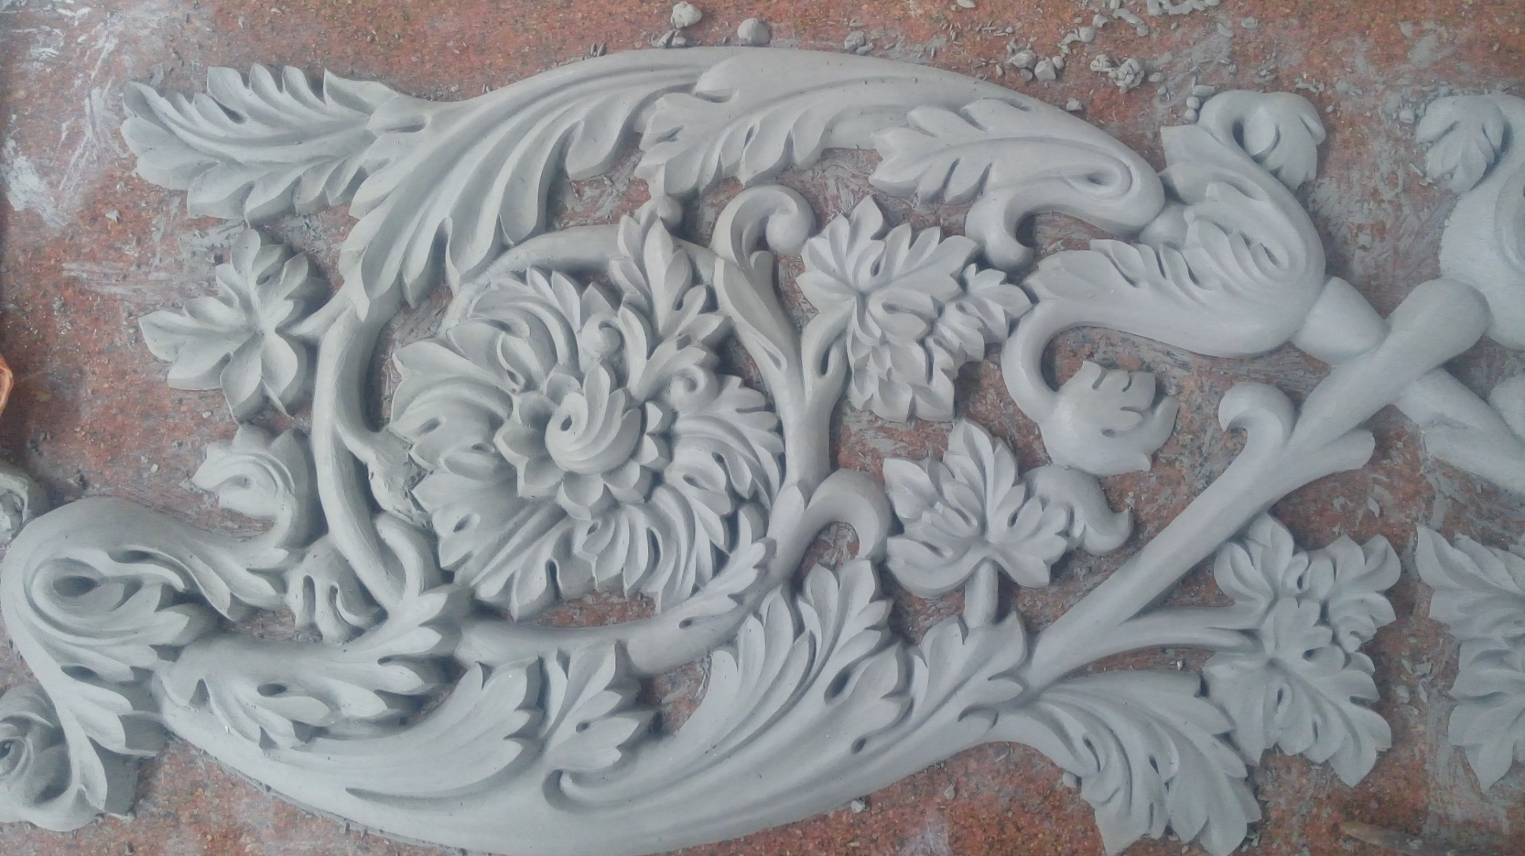
THE CLAYWORK DETAIL

Slide 17

MS STEEL FRAMEWORK FOR FIXING CORNICE

Slide 18
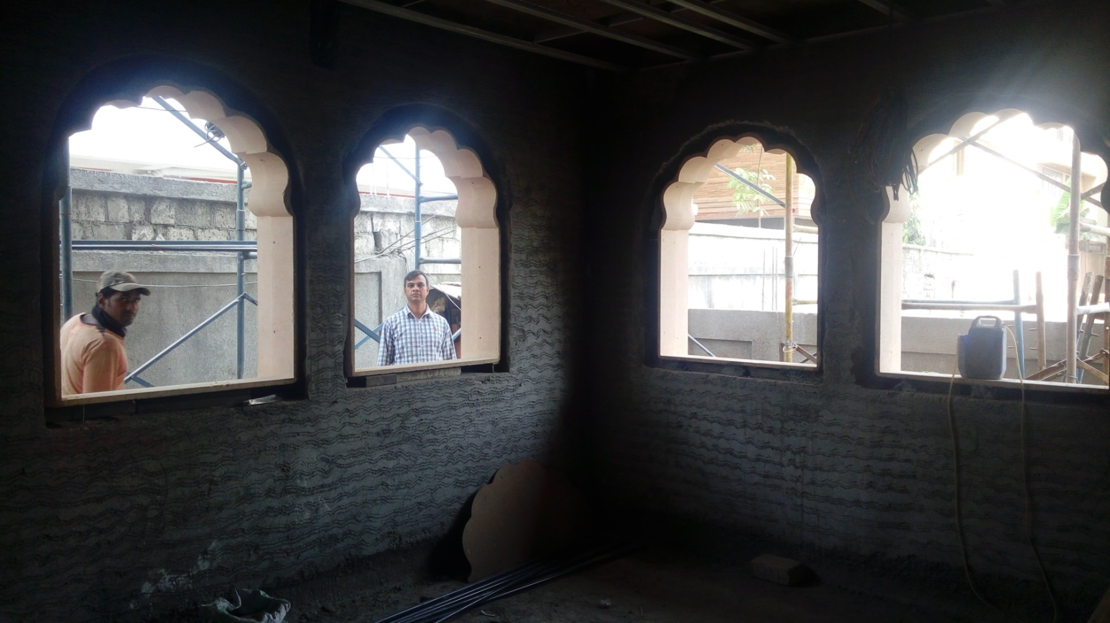
DECORATIVE WINDOW SURROUNDS

Slide 19
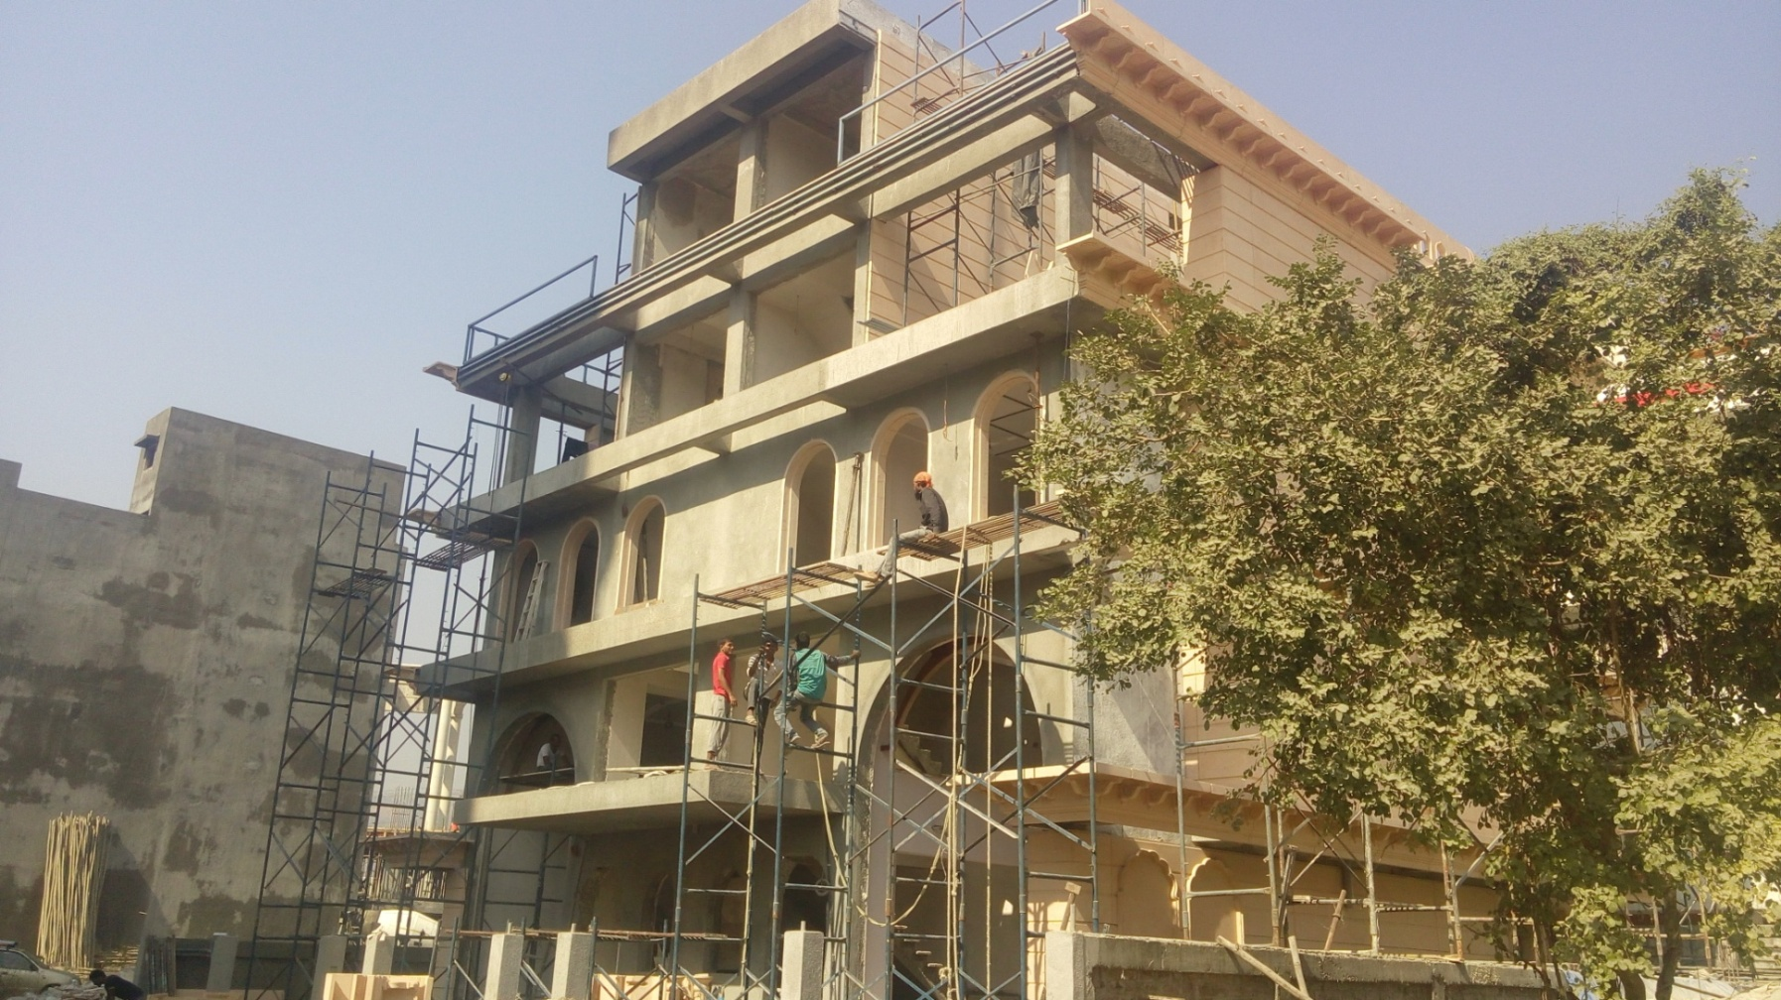
MS STEEL FRAMEWORK FOR CORNICE

Slide 20
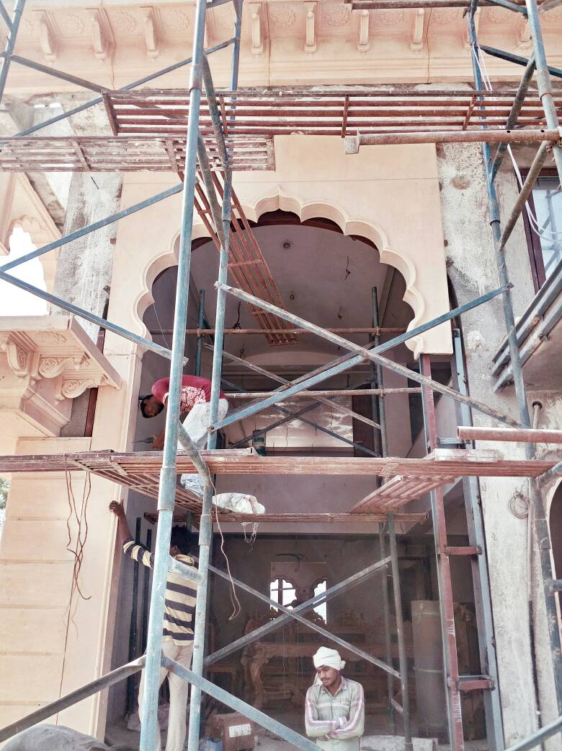
THE MAIN ARCH
MADE IN ONE PIECE FOR BETTER AESTHETICS, ON BOTH SIDES WITH 12MM THICK TOUFENED GLASS INBETWEEN WITH BANDS AT THE SIDES FOR AESTHETICS & SUPPORT

Slide 21
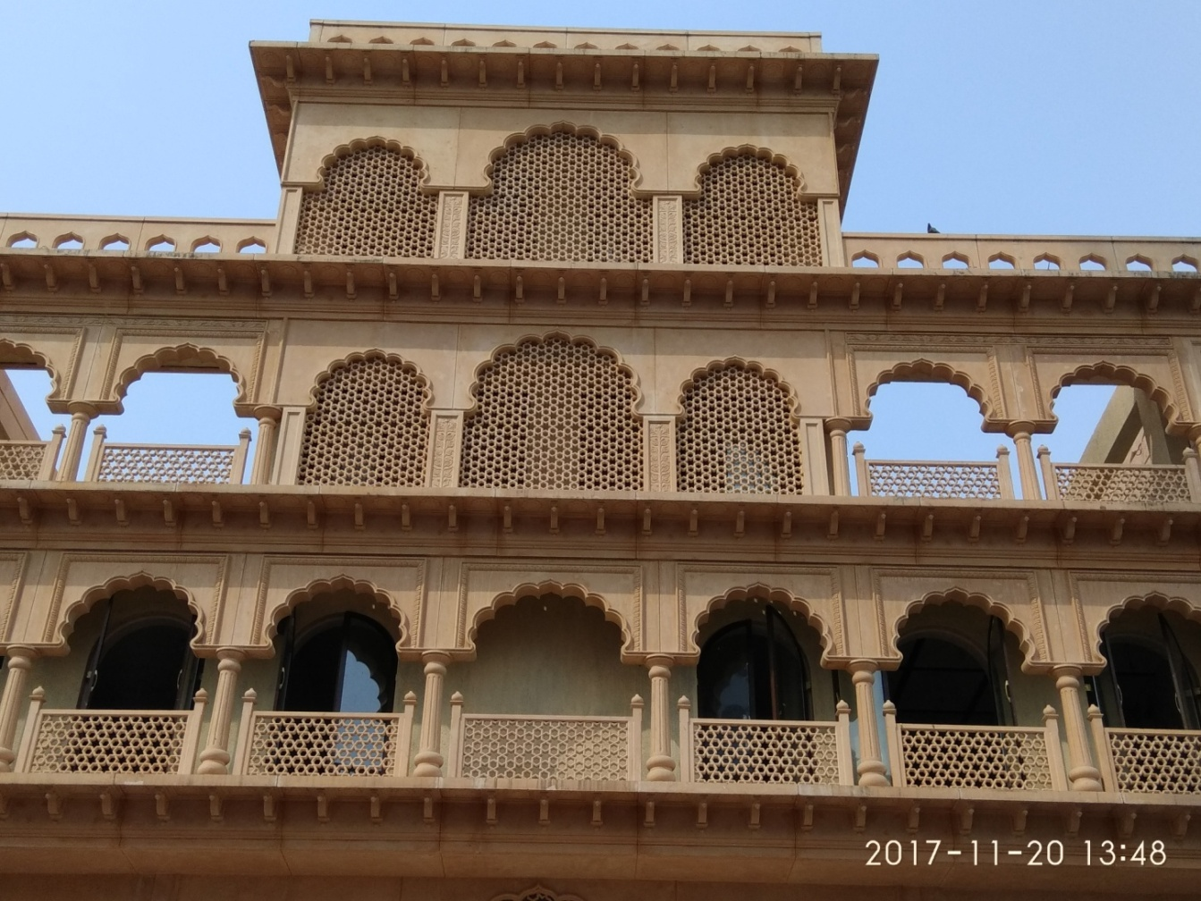
THE ARCH WITH JALI WORK

Slide 22
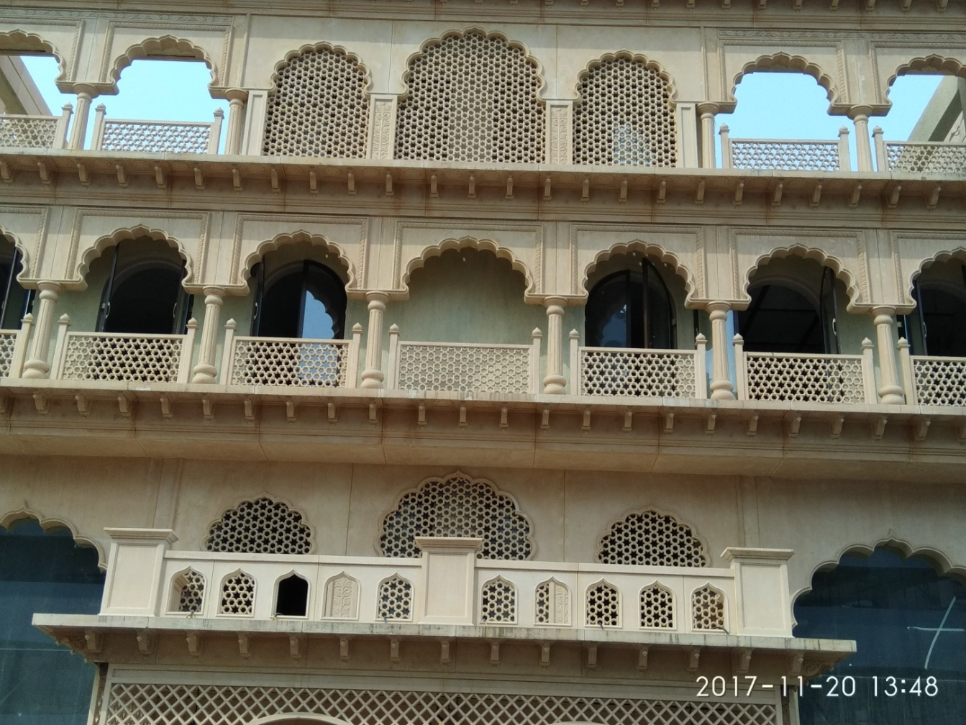
THE GRILL & CORNICE

Slide 23
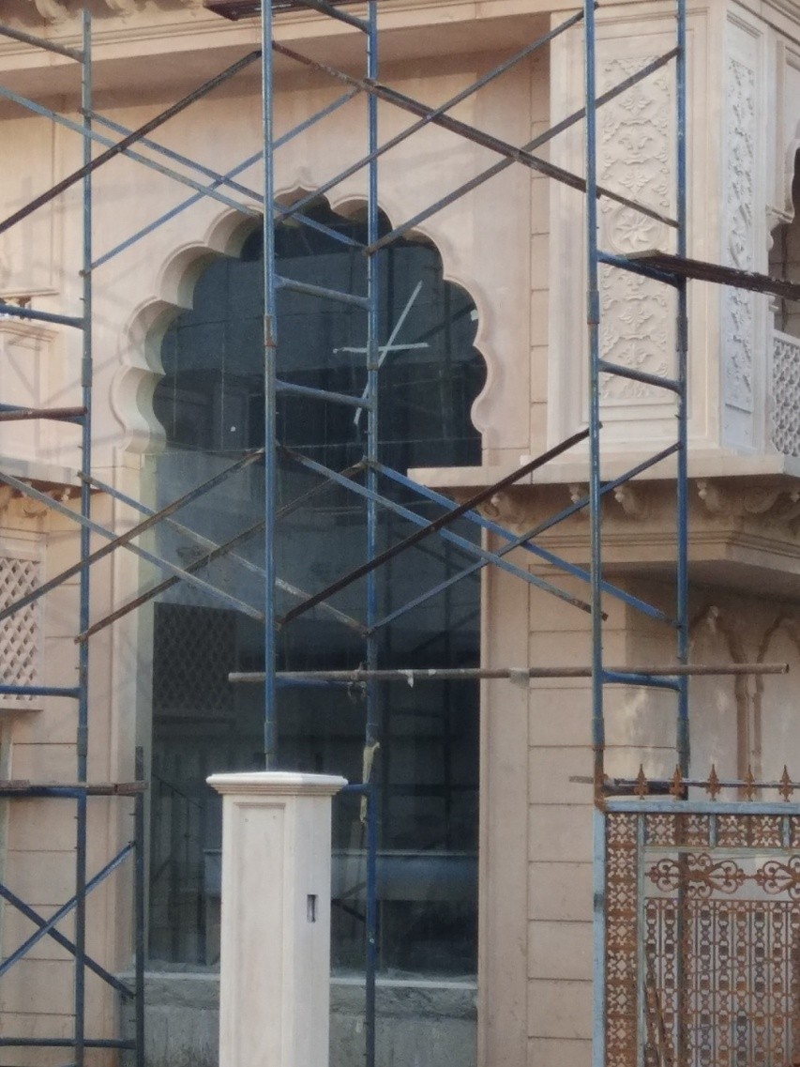
THE MAIN ARCH
MADE IN ONE PIECE FOR BETTER AESTHETICS, ON BOTH SIDES WITH 12MM THICK TOUFENED GLASS INBETWEEN WITH BANDS AT THE SIDES FOR AESTHETICS & SUPPORT

Slide 24
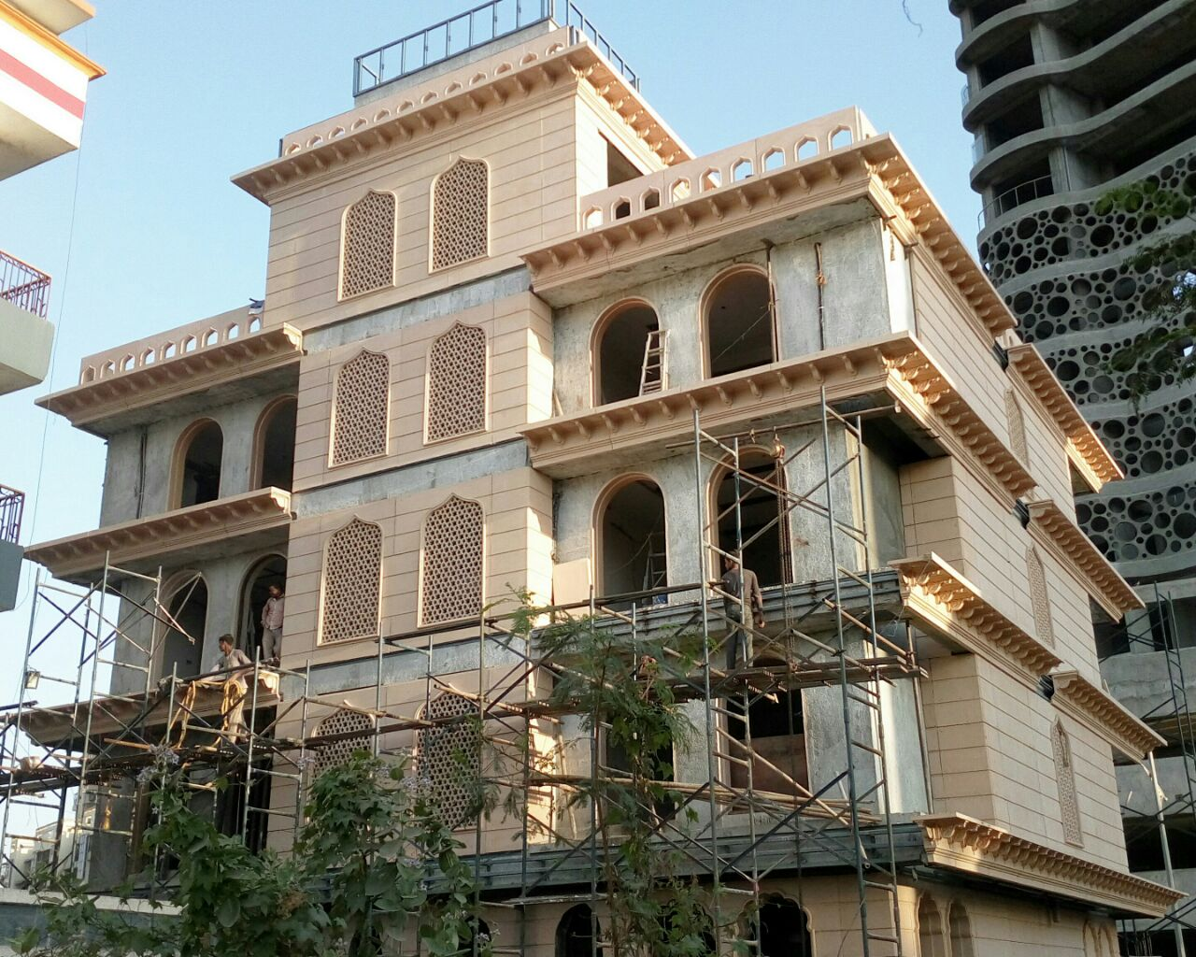
THE REAR VIEW
THE WASHROOMS BEING COVERED WITH GRC GRILL THAT NOT ONLY PROVIDE SUNLIGHT, BUT PRIVACY ALONG WITH ENCHANTING AESTHETICS.

Slide 25
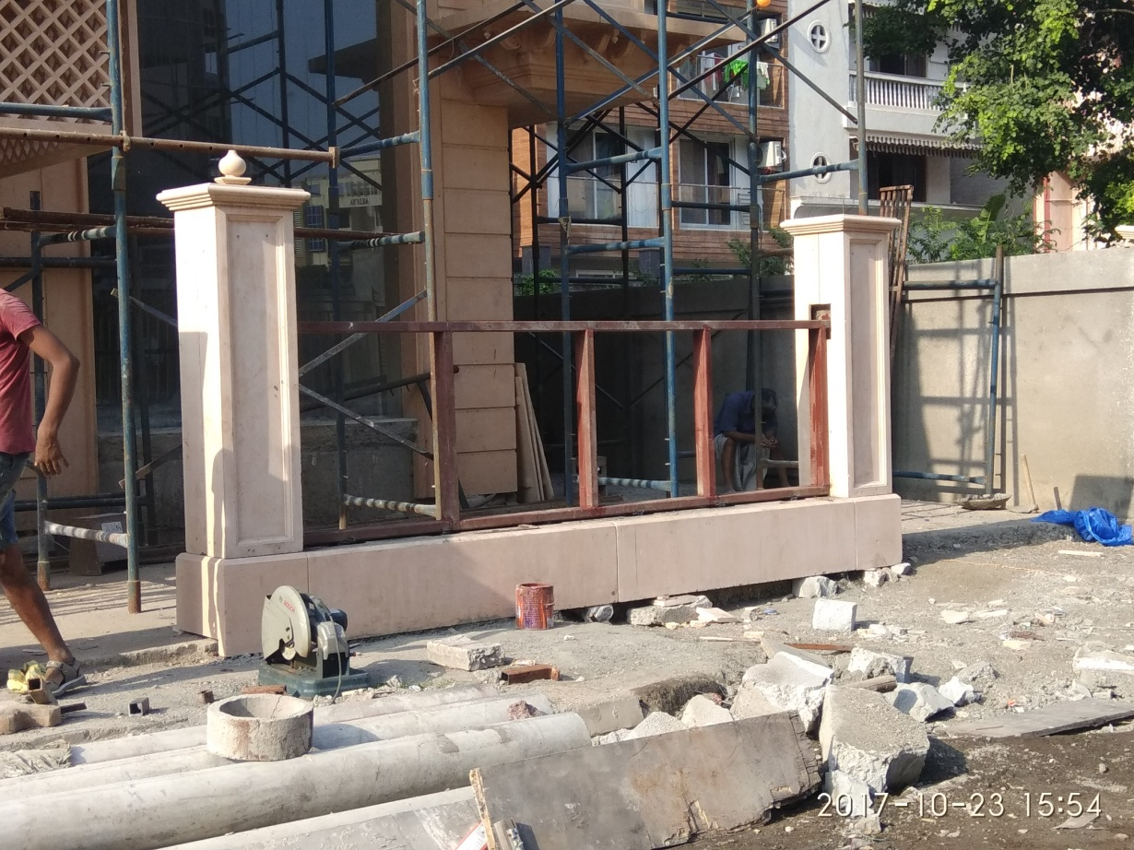
STEEL SUPPORT STRUCTURE FOR COMPOUND WALL
SQUARE TUBES USED FOR THE FRAMEWORK AND THE DECORATIVE PANEL USED BOTH SIDES TO COVER THE FRAME

Slide 26
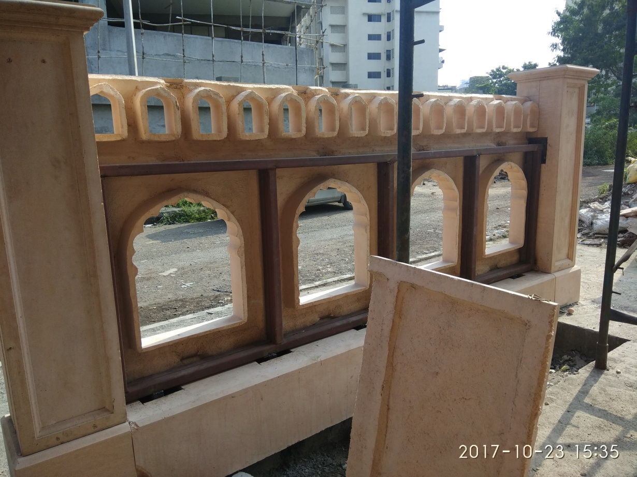
FIXING BOUNDARY WALL
BACK TO BACK APPLICATION
THE BOUNDARY WALL IS SELF SUPPORTED ON STEEL FRAME WORK ON A CONCRETE BASE & PILLARS
FRAME WORK SHOWN FOR REFERENCE

Slide 27
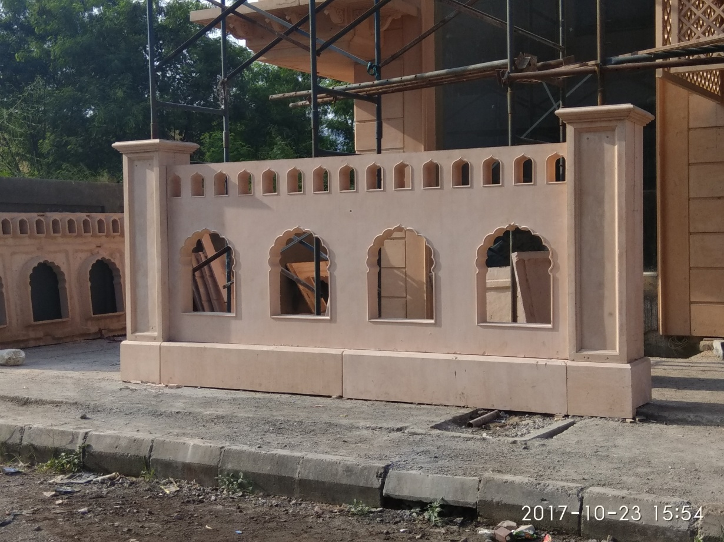
THE BOUNDARY WALL COMPLETED & FINISHED

Slide 28
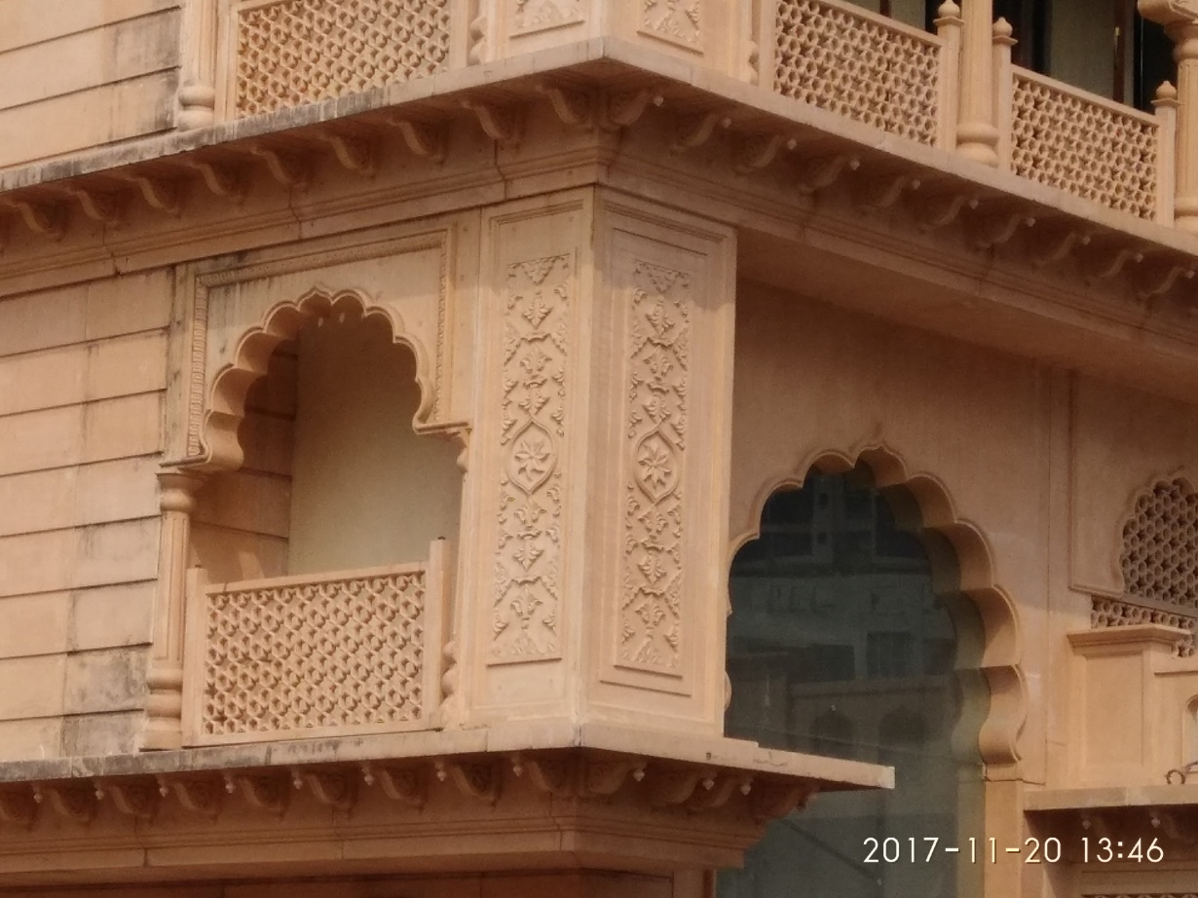
DECORATIVE JHAROKA WITH GRILL & DECORATIVE PANEL
THE CORNERS HAD TOBE BALANCED WITH THE USE OF THE DECORATIVE PANEL, FOR ACHIEVEING SYMETRY INTO THE DESIGN.

Slide 29
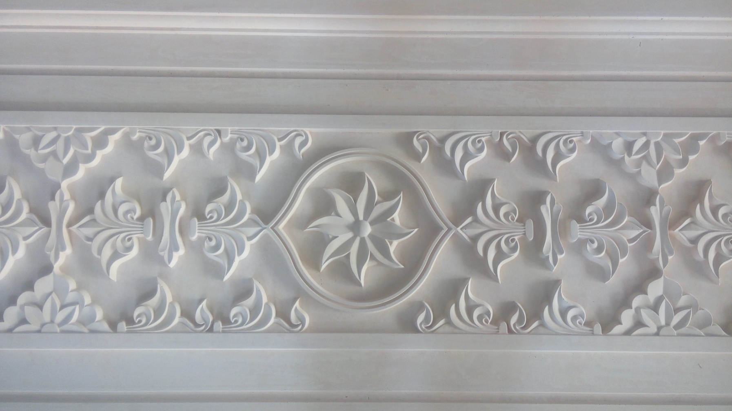
THE DECORATIVE PANEL

Slide 30
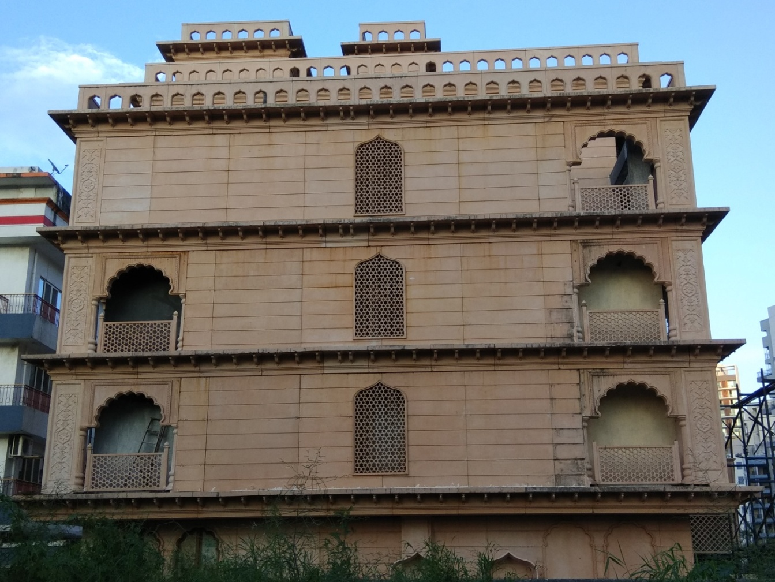
THE SIDE ELEVATION

Slide 31
CONTACT DETAILS
GFRC FACADES.
GFRC / GRC, GRG CEILINGS & PANELS, FRP WORKS, HIGH END DECORATIVE & ARCHITECTURAL WORKS & ACOUSTIC SOLUTIONS WITH EXPERTISE IN HOME THEATRES
SRIHARI NILKAR
MUMBAI
Mobile: 09867569395
nilkarsrihari@gmail.com

